Slide 1
CENG-232 Logic Design
Registers and Counters
Acknowledgement: Most of the following slides are adapted from Prof. Kale's slides at UIUC, USA.

Slide 2
Registers and Counters
Two types of commonly used sequential circuits.
Register is a group of flip-flops each storing one bit of information.
Registers are built-up by using flip-flops and gates:
flip-flops hold the information, gates control how the information is transferred to the register.
Counter is a register that can go through a predetermined sequence of states.

Slide 3
What good are registers?
Flip-flops are limited in size because they can store only one bit.
We had to use two flip-flops for our two-bit counter examples.
Most computers work with integers and floating-point numbers that are 32-bits or 64-bits long.
Registers are commonly used as temporary storage in a processor (PL variables are mapped to registers).
They are faster and more convenient than main memory.
More registers can help speed up complex calculations.

Slide 4
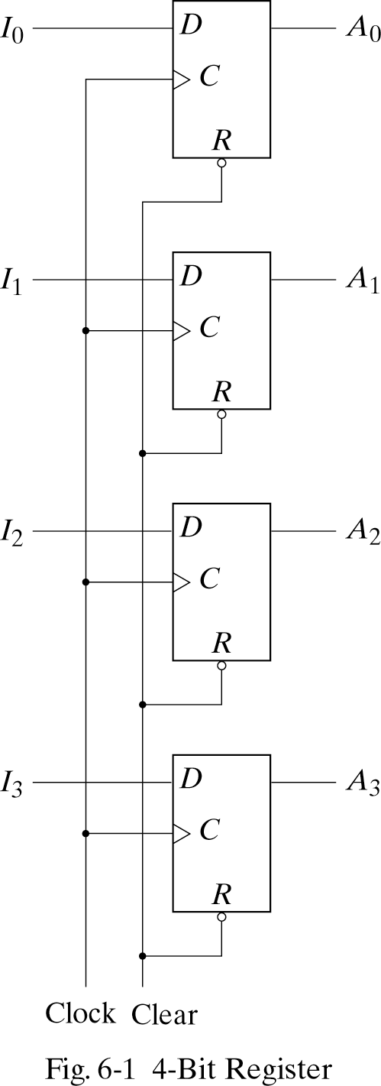
4-bit Register
Loads in parallel
Clear: cleans the output to all 0’s.
The value of ( I3, I2,I1, I0) immediately before the clock edge determines the value of (A3,A2,A1,A0) after the clock edge.
The outputs can be sampled at any time to obtain the binary information stored in the register.
What if we want to keep the content of the register the same?

Slide 5
4-bit Register
Two possible solutions:
1) Keep the input the same
What is the problem with this solution?
The data bus driving the register would be unavailable for other traffic.
2) Control the clock signal
What is the problem with this solution?
To fully synchronize, the system clock signals should arrive at the same time at all flip-flops.

Slide 6
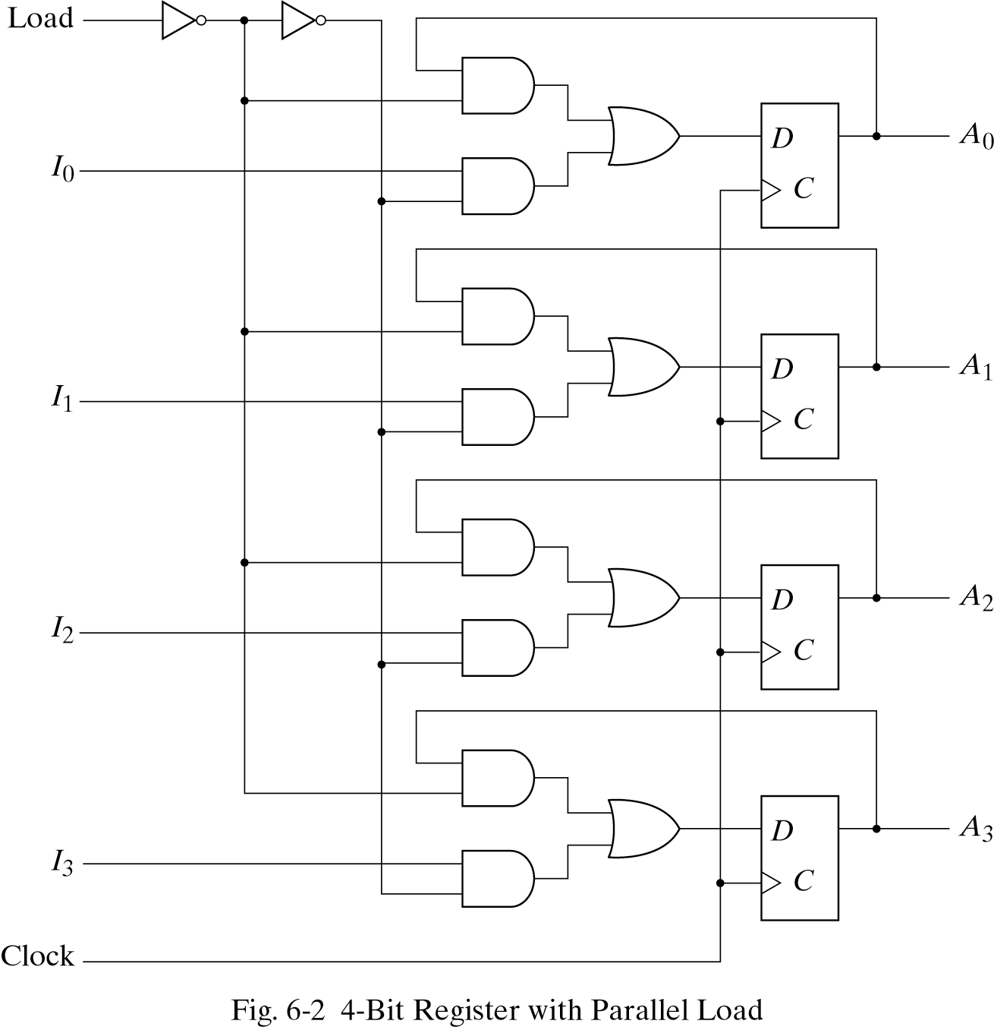
Solution: Register with Parallel Load
Use two-channel multiplexers to select the FF inputs:
Current state or new input (Ix)
Load = 1, we load data (from the input lines)
Load = 0, register content does not change (loads data from current state)
1
0
I₀
1
0
I₁
1
0
I₂
1
0
I₃
1

Slide 7
Implementing Sequential Circuits
Using a register with parallel load capability, one can implement arbitrary sequential circuits.
The register can act as the memory component of the sequential circuit.
Input
Combinational
Logic
Output
Register
Sequential Circuit

Slide 8
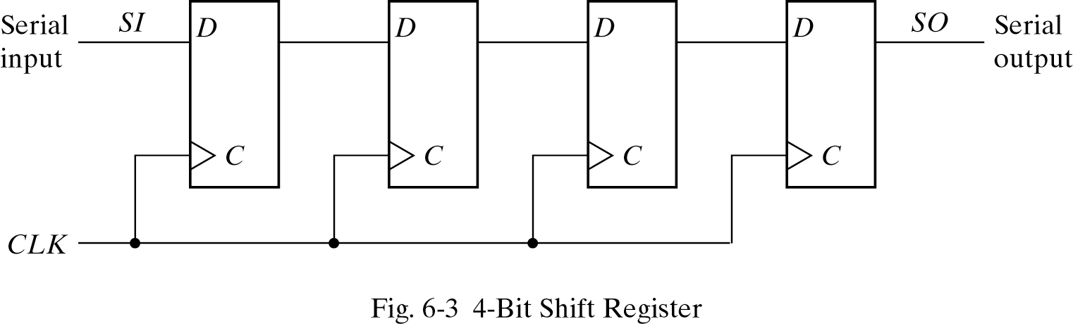
Shift Registers
A register capable of shifting its binary information in one or both directions is called “shift register”.
101101

Slide 9
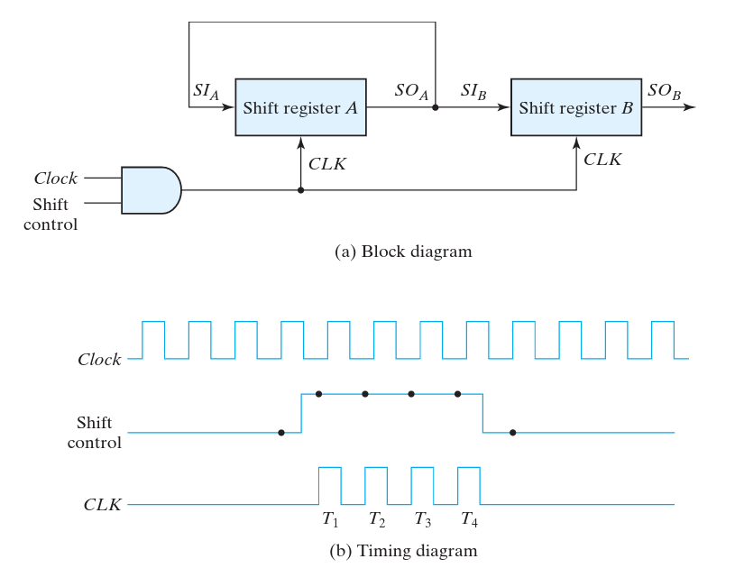
Serial Transfer

Slide 10
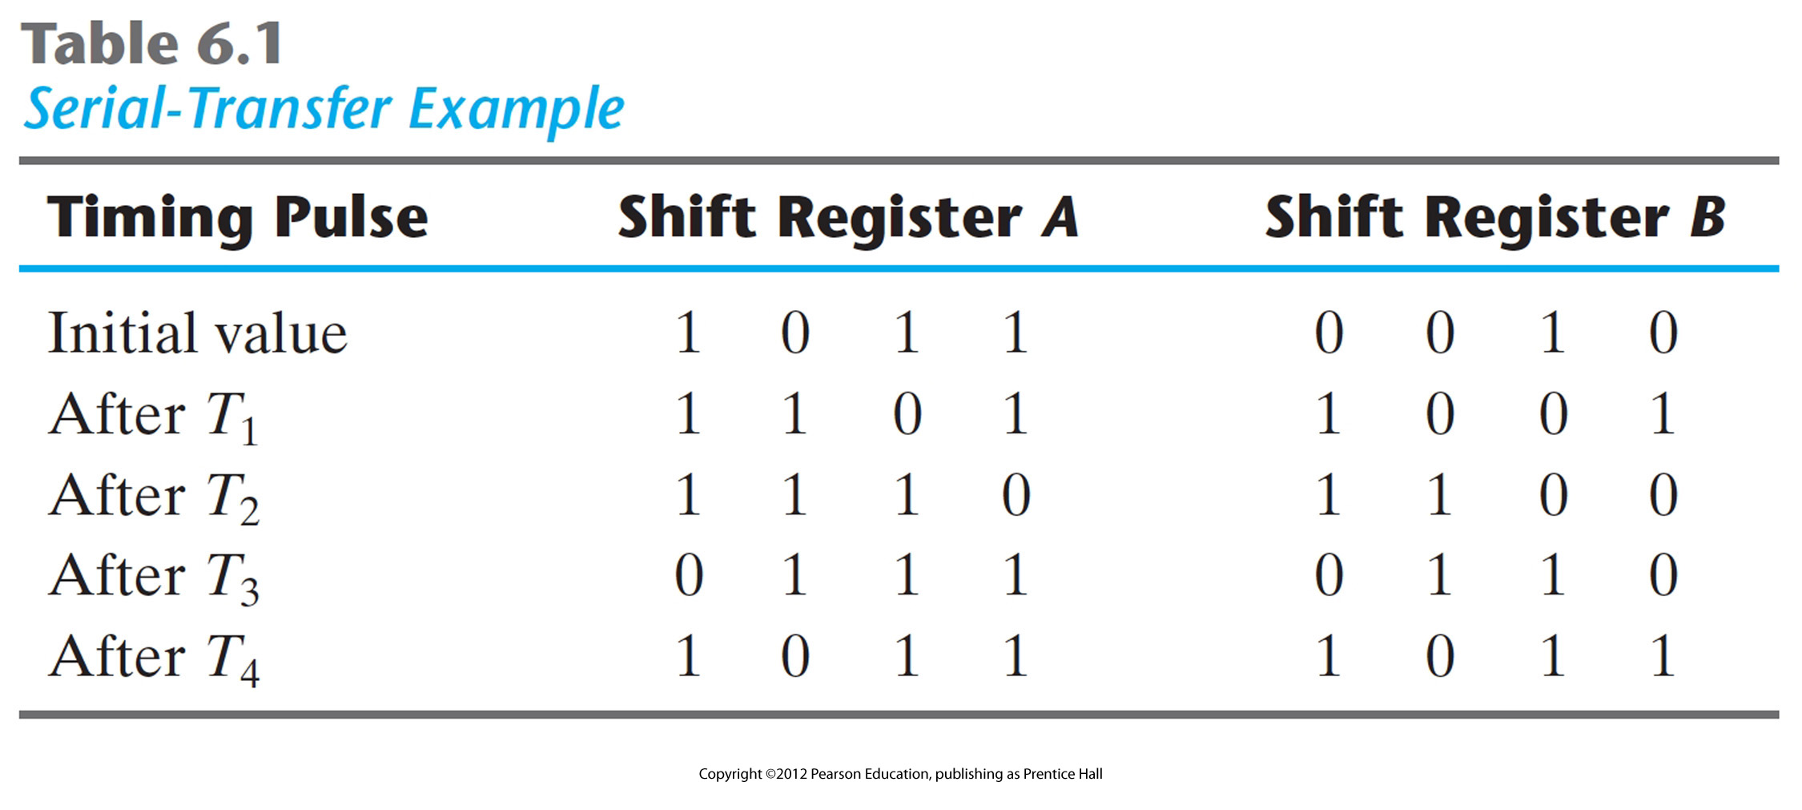
Table Showing Shift
A digital system is in the serial mode when information is processed one bit at a time (bit after bit).

Slide 11

Serial data transfer
One application of shift registers is converting between “serial data” and “parallel data.”
Computers typically work with multiple-bit quantities.
ASCII text characters are 8 bits long.
Integers, single-precision floating-point numbers, and screen pixels are up to 32 bits long.
But sometimes it’s necessary to send or receive data serially, or one bit at a time. Some examples include:
Input devices such as keyboards and mice.
Output devices like printers.
Any serial port, USB or Firewire device transfers data serially.

Slide 12
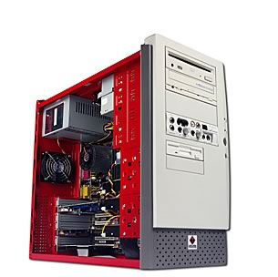

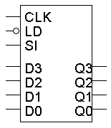
Receiving serial data
To receive serial data using a shift register:
The serial device is connected to the register’s SI input.
The shift register outputs Q3-Q0 are connected to the computer.
The serial device transmits one bit of data per clock cycle.
These bits go into the SI input of the shift register.
After four clock cycles, the shift register will hold a four-bit word.
The computer then reads all four bits at once from the Q3-Q0 outputs.
serial device
computer

Slide 13

Sending data serially
To send data serially with a shift register, you do the opposite:
The CPU is connected to the register’s D inputs.
The shift output (Q3 in this case) is connected to the serial device.
The computer first stores a four-bit word in the register, in one cycle.
The serial device can then read the shift output.
One bit appears on Q3 on each clock cycle.
After four cycles, the entire four-bit word will have been sent.
computer
serial device

Slide 14
Serial vs. Parallel
Communication / Interfaces
RS-232 / Centronix
USB
SATA / PATA
Peripheral component interconnect: PCI / PCI-X / PCI-e (Serial)
Notes:
The Centronics parallel interface is an older and still widely-used standard I/O interface for connecting printer s and certain other devices to computers. The interface typically includes a somewhat cumbersome cable and a 36- pin male and female connector at the printer or other device. The cable plugs into a 25-pin parallel port on the computer. Data flows in one direction only, from the computer to the printer or other device. In addition to eight parallel data lines, other lines are used to read status information and send control signals. Centronics Corporation designed the original Centronics parallel interface for dot matrix printers. In 1981, IBM used this interface as an alternative to the slower one-bit-at-a-time serial interface.

Slide 15
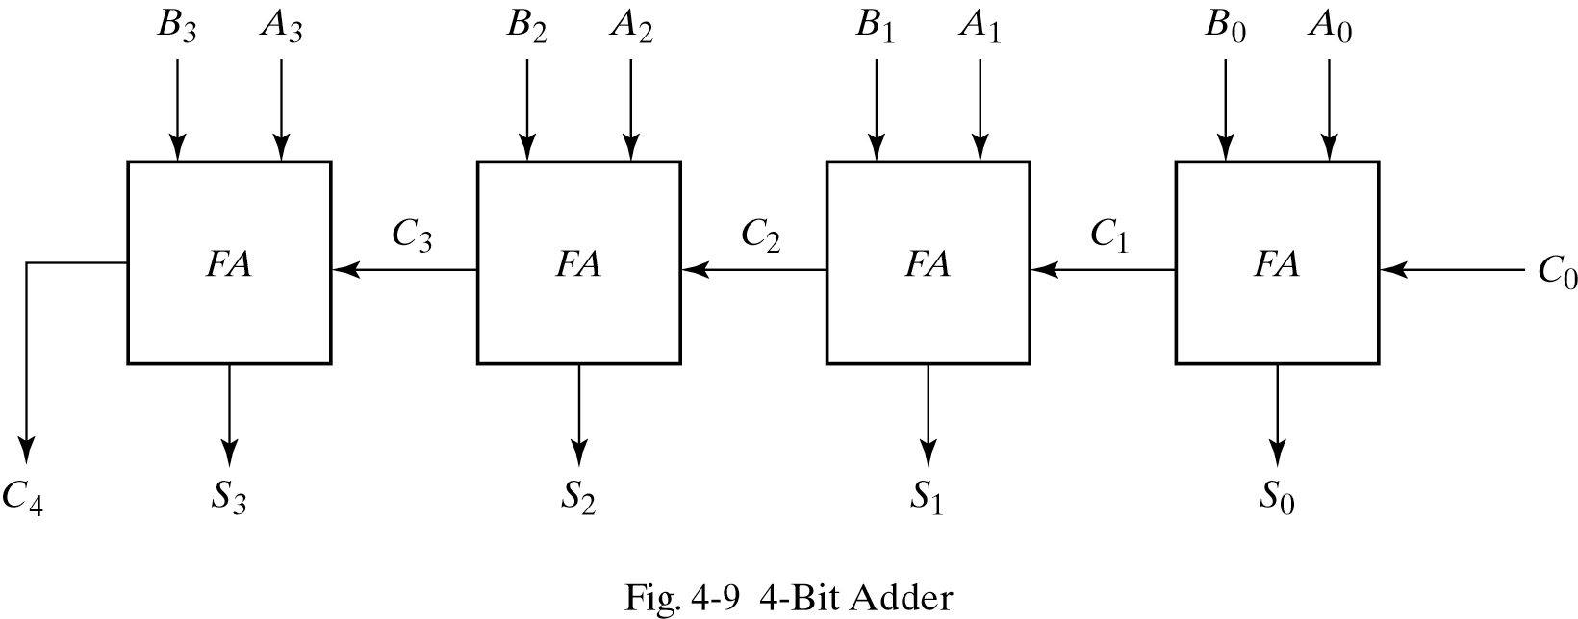
Remember the 4-bit Parallel Adder

Slide 16
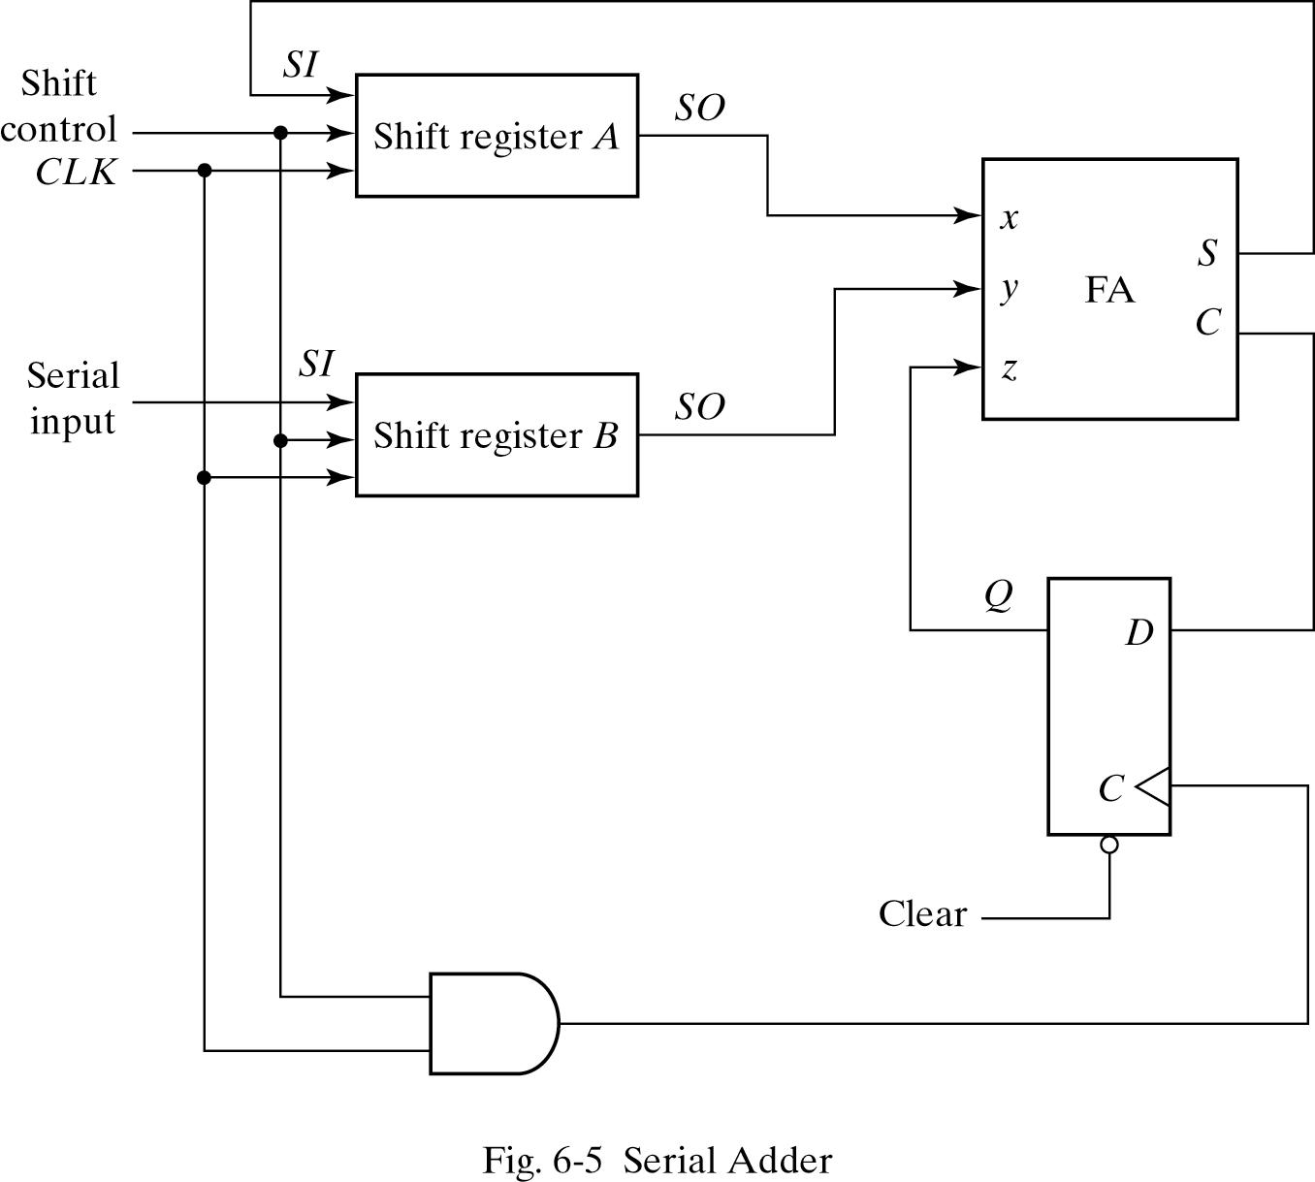
Serial Addition
Slower compared to parallel addition, but uses less equipment.

Slide 17
Serial Adder vs. Parallel Adder
PA uses registers with parallel load, SA uses shift registers.
PA uses more FAs compared to SA.
Excluding the registers, PA is a combinational circuit, SA is sequential.
Slides adapted from Amirali Baniasadi
amirali@ece.uvic.ca

Slide 18
Serial Adder: Design Procedure
State Table for a Serial Adder
Present State Inputs Next State Output Flip-Flop inputs
Q x y Q S J0 K0
0 0 0 0 0 0 x
0 0 1 0 1 0 x
0 1 0 0 1 0 x
0 1 1 1 0 1 x
1 0 0 0 1 x 1
1 0 1 1 0 x 0
1 1 0 1 0 x 0
1 1 1 1 1 x 0
J0 = xy K0 = x’y’ = (x+y)’ S = x XOR y XOR z

Slide 19
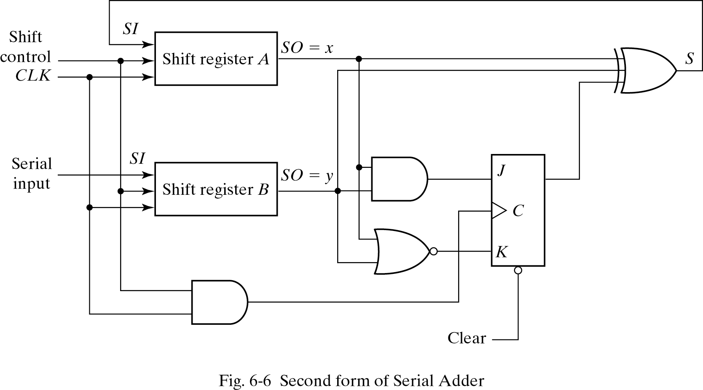
Serial 4-bit Serial Adder Circuit

Slide 20
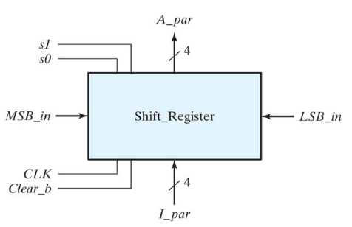
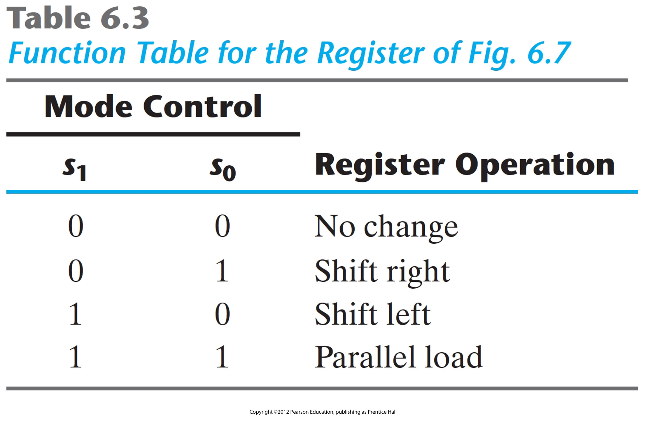
Universal Shift Register
A register capable of shifting in both directions and loading in parallel.

Slide 21
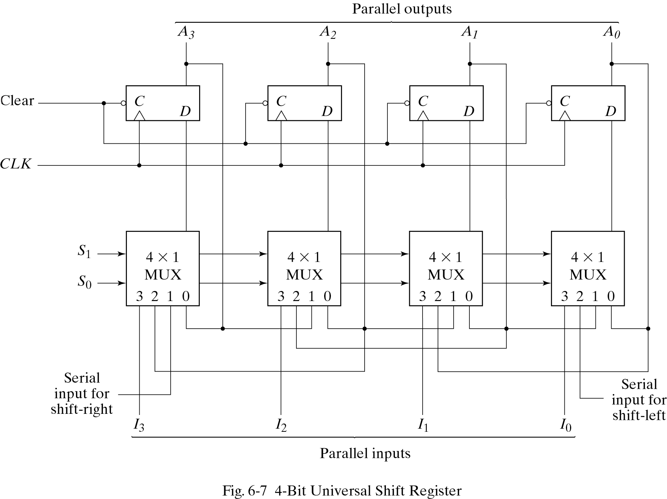
Universal Shift Register
A register capable of shifting in both directions and loading in parallel.
Stores Information
Multiplexer Inputs:
0: No Change
1: Shift Right
2: Shift Left
3: Parallel load
Controls information transfer

Slide 22
Counters
A register that goes trough a prescribed sequence of states is called a counter.
Binary counter
Counts through binary sequence
n bit counter counts from 0 to 2^{n}
There are two groups of counters: “Ripple counters” and “Synchronous counters”.
Ripple counters: The flip-flop output triggers other flip-flops in sequence.
Synchronous counters count the clock.

Slide 23
Where (for what purpose) do we use counters?
To keep track of “time” (Absolute/Relative timing)
To count how many times something has happened.
How many bits/bytes have been sent or received?
How many steps have been performed in some computation?
All processors contain a program counter, or PC.
Programs consist of a list of instructions that are to be executed one after the other (for the most part; except ?).
The PC keeps track of the instruction currently being executed.
The PC increments once on each instruction cycle, and the next program instruction is then executed.
Notes:
The CPU contains a number of special purpose registers; the most important of these is called the program counter. The program counter contains the address of the next instruction.
The program counter is usually the same width (number of bits) as the address bus. It is quite common in computer systems to have more memory space than actual memory. If 13 only bits were used, the memory could contain 8K instructions. If 24 bits were used it could address 16 MB of memory.
Usually the contents of the program counter are automatically increased by 1 during every instruction. Thus the processor executes the instructions in a list one by one. There are other possibilities, to allow jumping (branching or procedure calls) to another part of the program. This is done by altering the contents of the program counter.

Slide 24
Binary Ripple Counter
A binary ripple counter consists of a series of complementing flip-flops
The output of each flip-flop connected to the next higher order flip-flop.
Does not use the clock signal (asynchronous)
Instead, a flip-flop output transition serves as a trigger for other flip-flops.

Slide 25
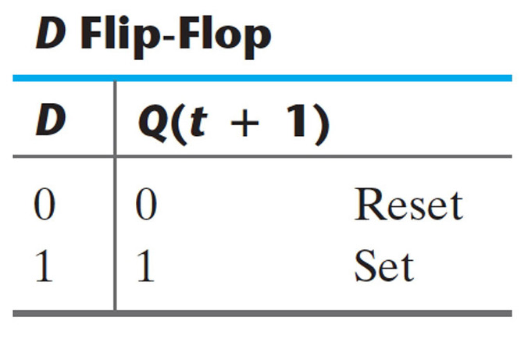
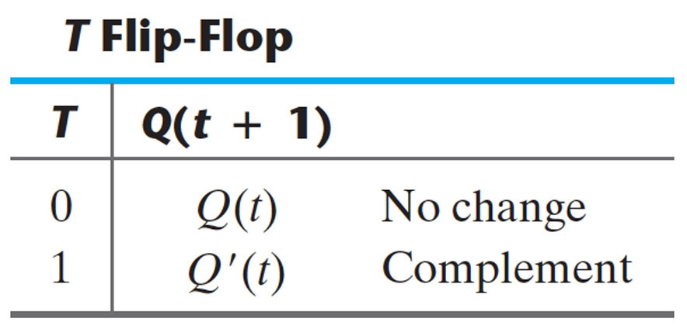
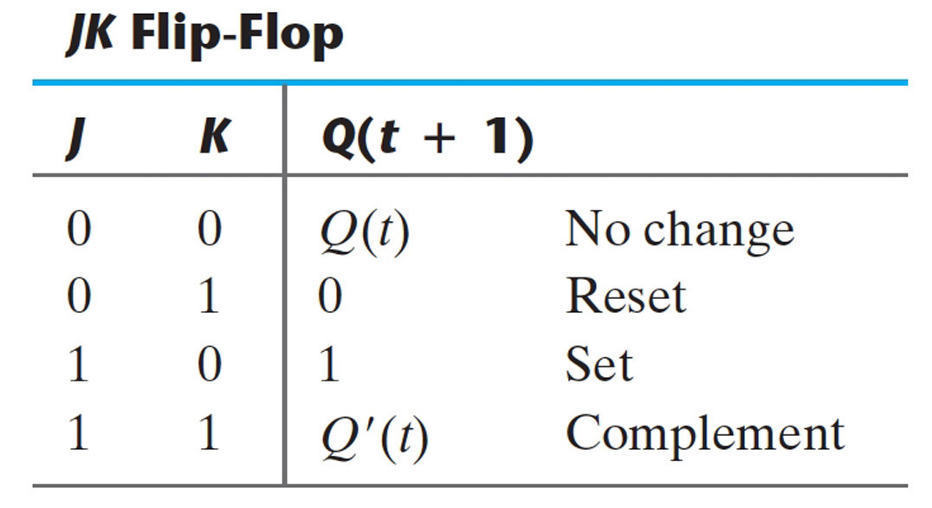
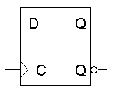
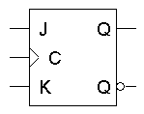
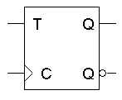
Flip-flops

Slide 26
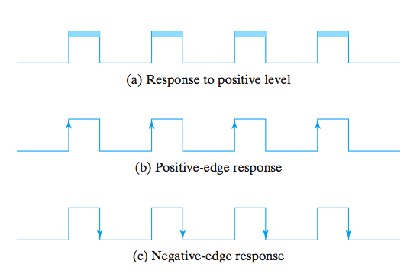
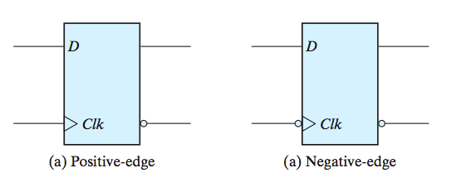
Responding to a Clock
Clock response in latch (a) and flip-flops (b-c).

Slide 27
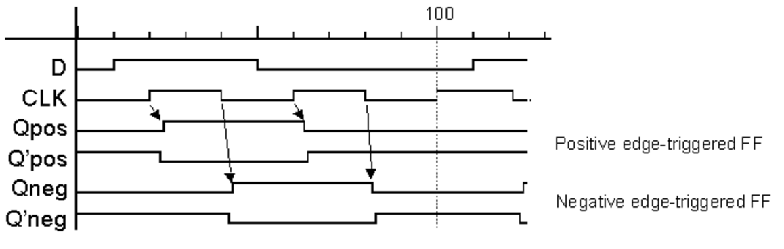
Timing diagram

Slide 28
Binary Ripple Counter
Binary Count Sequence
A3 A2 A1 A0
0 0 0 0
0 0 0 1 A0 is complemented at each count pulse
0 0 1 0 A1 is complemented when A0 goes from 1 to 0
0 0 1 1
0 1 0 0 A2 is complemented when A1 goes from 1 to 0
0 1 0 1
0 1 1 0
0 1 1 1
1 0 0 0 A3 is complemented when A2 goes from 1 to 0

Slide 29
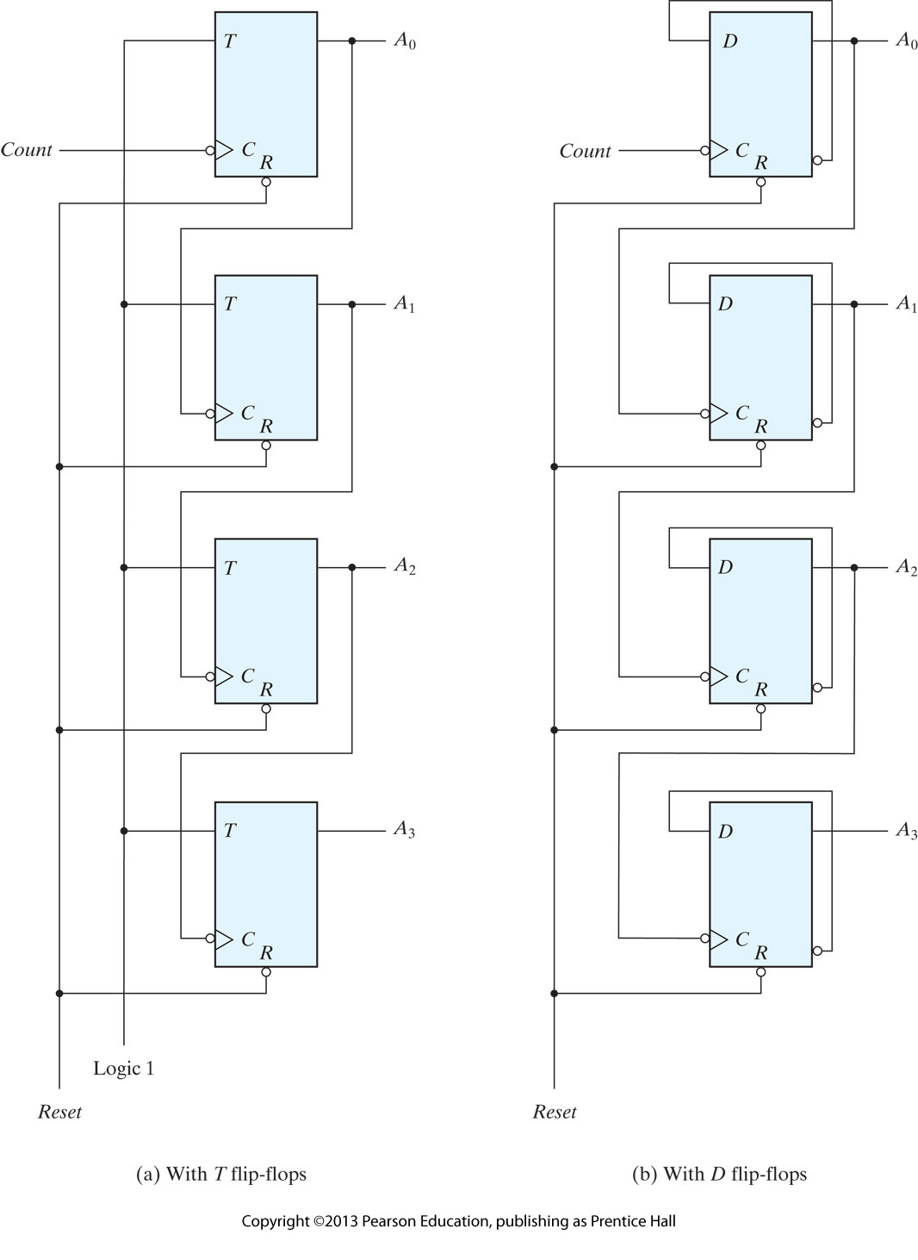
Examples of Ripple Counters
Notice: no clocks!

Slide 30
Count-down Binary Ripple Counter
Count-down counter: A binary counter with reverse count.
E.g. using 4-bits: it starts from 15 and goes down.
In a count-down counter, the least significant bit is complemented with every count pulse. Any other bit is complemented if the previous bit goes from 0 to 1.
Therefore, we can use the same counter design with positive edge flip-flops to make a count-down flip-flop.

Slide 31
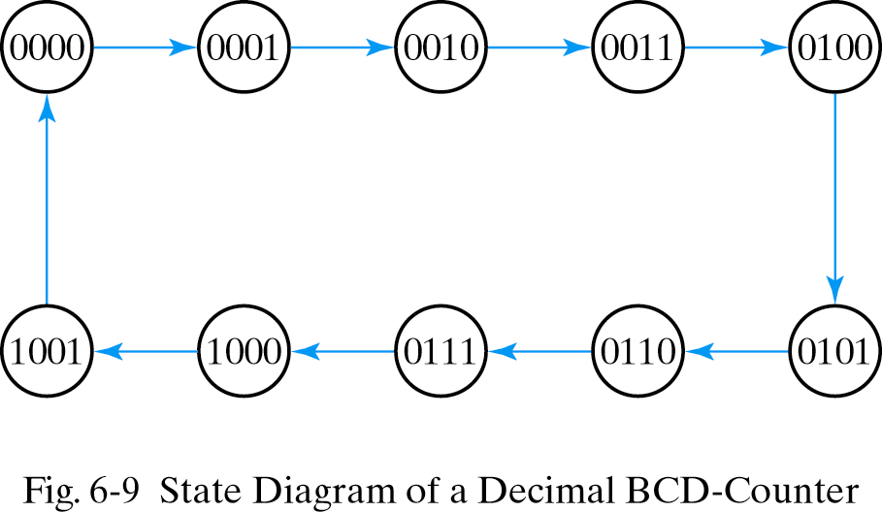
BCD Ripple Counter
A BCD (Binary Coded Decimal) counter starts from 0 ends at 9.
How does a BCD counter differ from a general binary ripple counter (shown in the previous slide)?

Slide 32
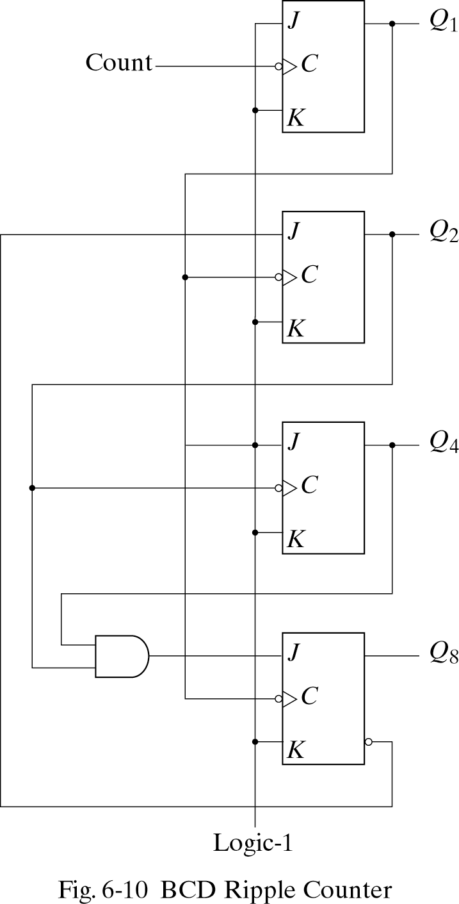
Logic Diagram of Ripple Counter
Remember that when the C input goes from 1 to 0,
the flip‐flop is set if J=1,
it is cleared if K= 1,
it is complemented if J=K=1,
and it is left unchanged if J=K=0 .

Slide 33
Logic Diagram of Ripple Counter
Q1 changes state after each clock pulse. (count, in this case).
Q2 complements every time Q1 goes from 1 to 0,
as long as Q8=0. When Q8 becomes 1, Q2 remains at 0.
Q4 complements every time Q2 goes from 1 to 0.
Q8 remains at 0 as long as Q2 or Q4 is 0.
When both Q2 and Q4 become 1, Q8 complements when Q1 goes from 1 to 0.
Q8 is cleared on the next transition of Q1.
Study this!!

Slide 34
Question
How do you build a counter that counts from 0 to 999 using BCD counters? How many do you need?

Slide 35
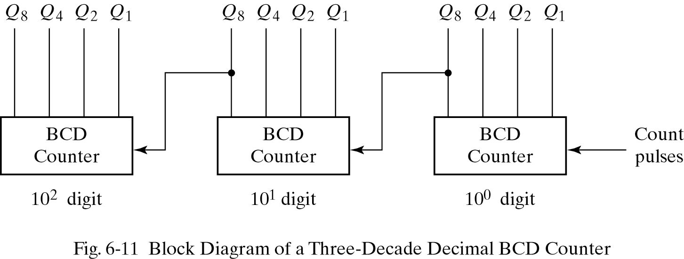
Three-Decade Decimal BCD Counter
Counts from 0 to 999: When Q₈ goes from 1 to 0 the next higher order decade is triggered

Slide 36
Synchronous counters
Contrary to the ripple counters (which are async.), these counters use the clock.
Clock pulses are applied to the C inputs of all flip-flops.

Slide 37
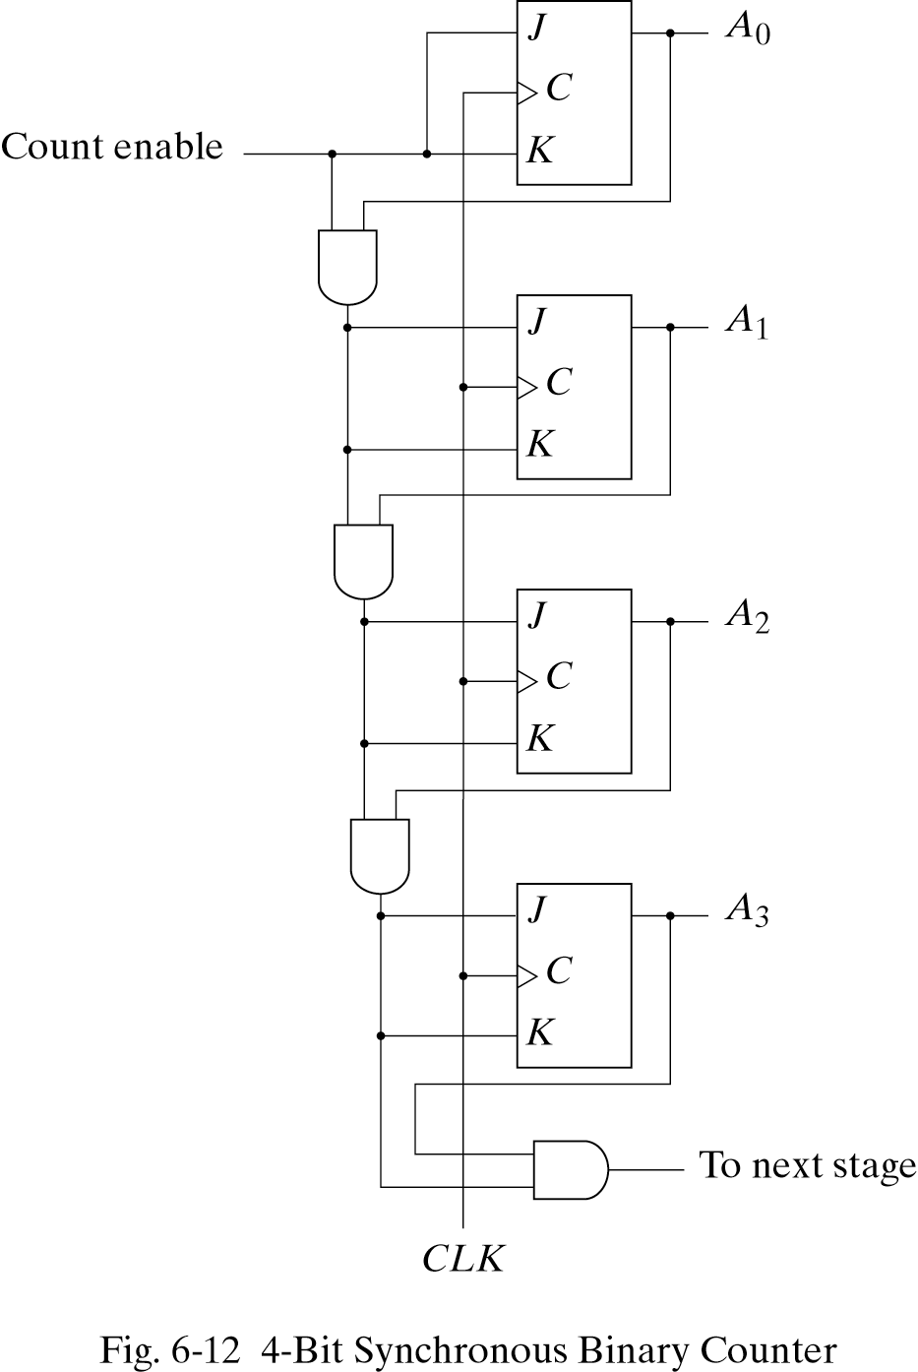
4-bit Synchronous Binary Counters
A₃ A₂ A₁ A₀
0 0 0 0
0 0 0 1
0 0 1 0
0 0 1 1
0 1 0 0
0 1 0 1
0 1 1 0
0 1 1 1
1 0 0 0
A0 is complemented at every clock pulse.
For all others: A flip-flop is complemented if all lower bits are 1.

Slide 38
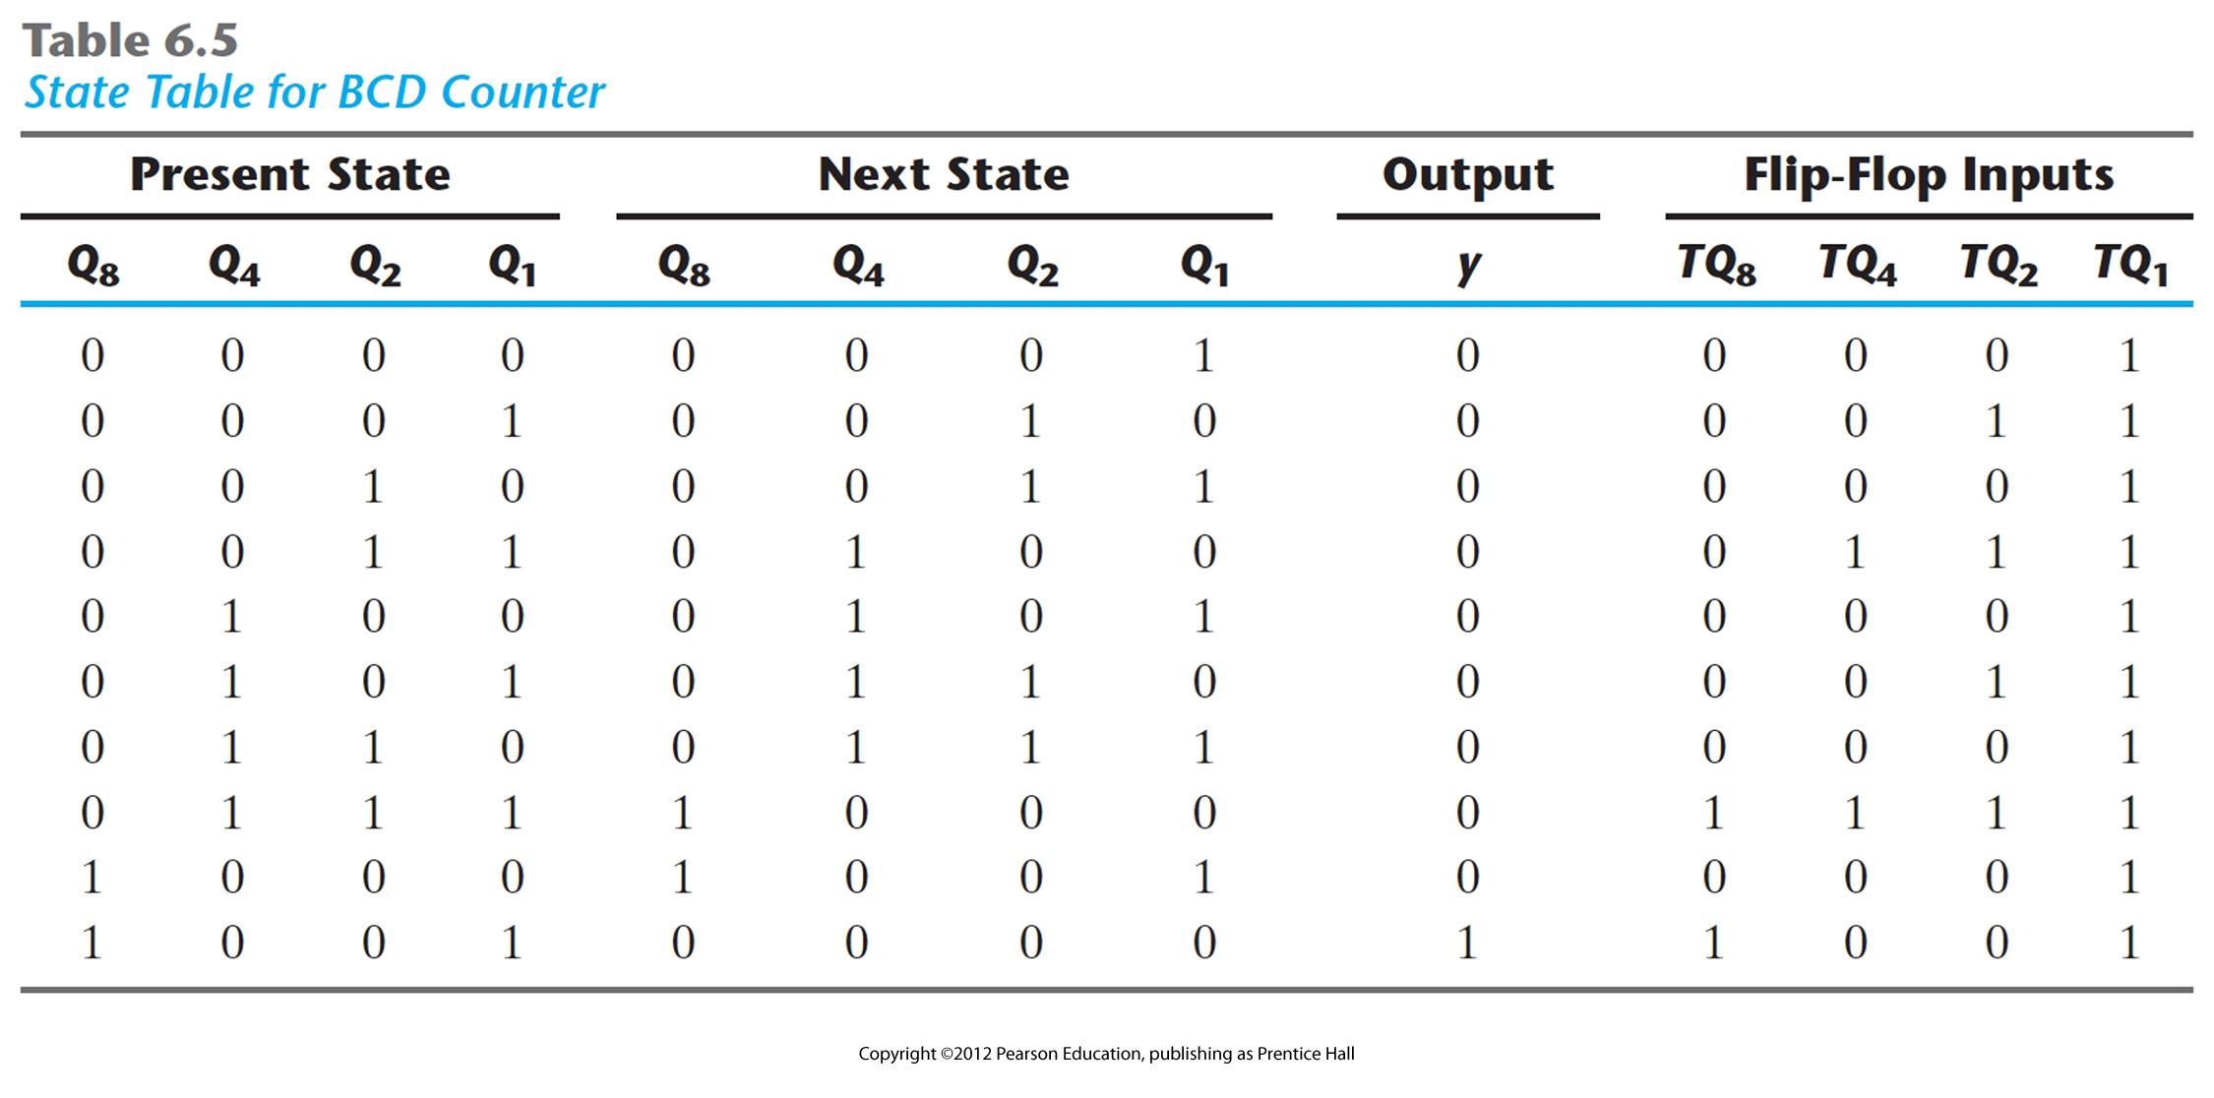
Synchronous BCD Counter

Slide 39
Question
Build a synchronous counter that has up and down control inputs. When up=1 & down=0, the counter should count up, when up=0 & down=1, the counter should count down.

Slide 40
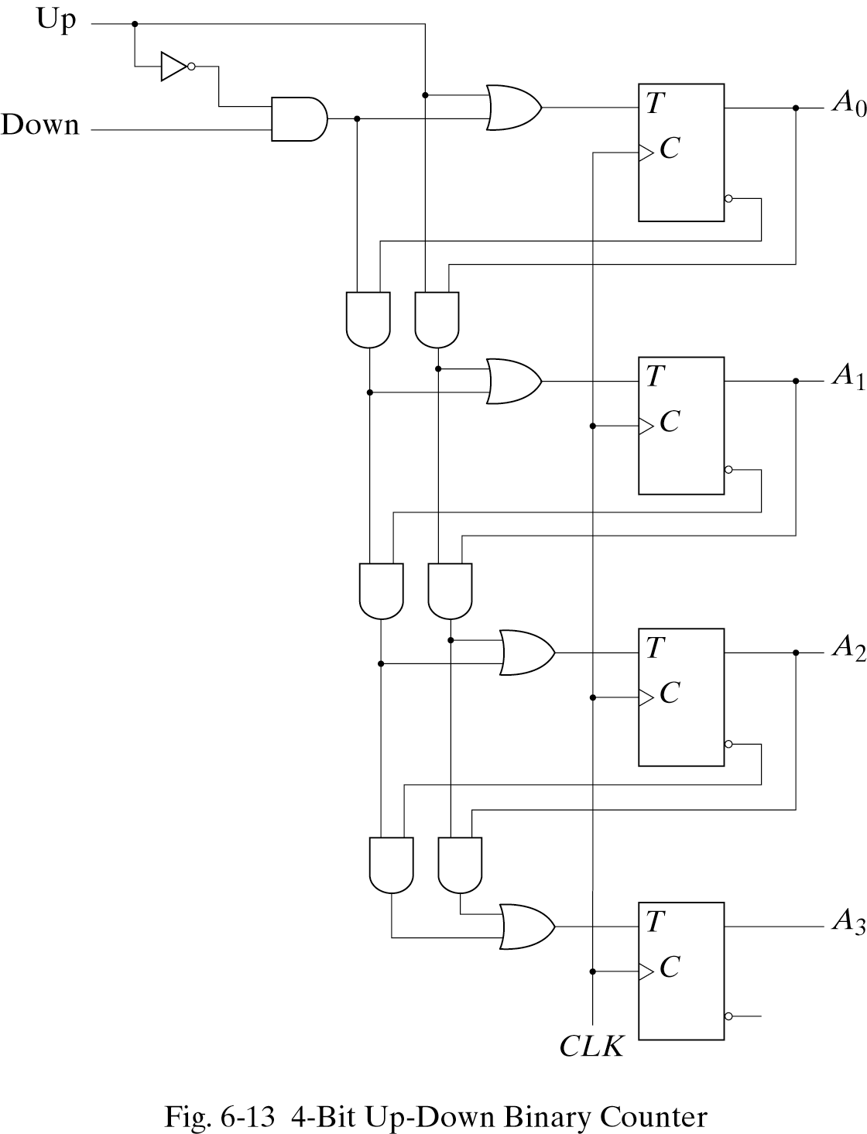
4-bit Up-Down Binary Counters
In a count-down binary counter,
The least significant bit is always complemented,
a bit is complemented if all lower bits are 0.
Change an up counter to a down counter: The AND gates should come from the complement outputs instead of the normal one
Up = 1, Down =0: Circuit counts up since input comes from Normal output
Up = 0, Down =1: Circuit counts down since input comes from Complemented output

Slide 41
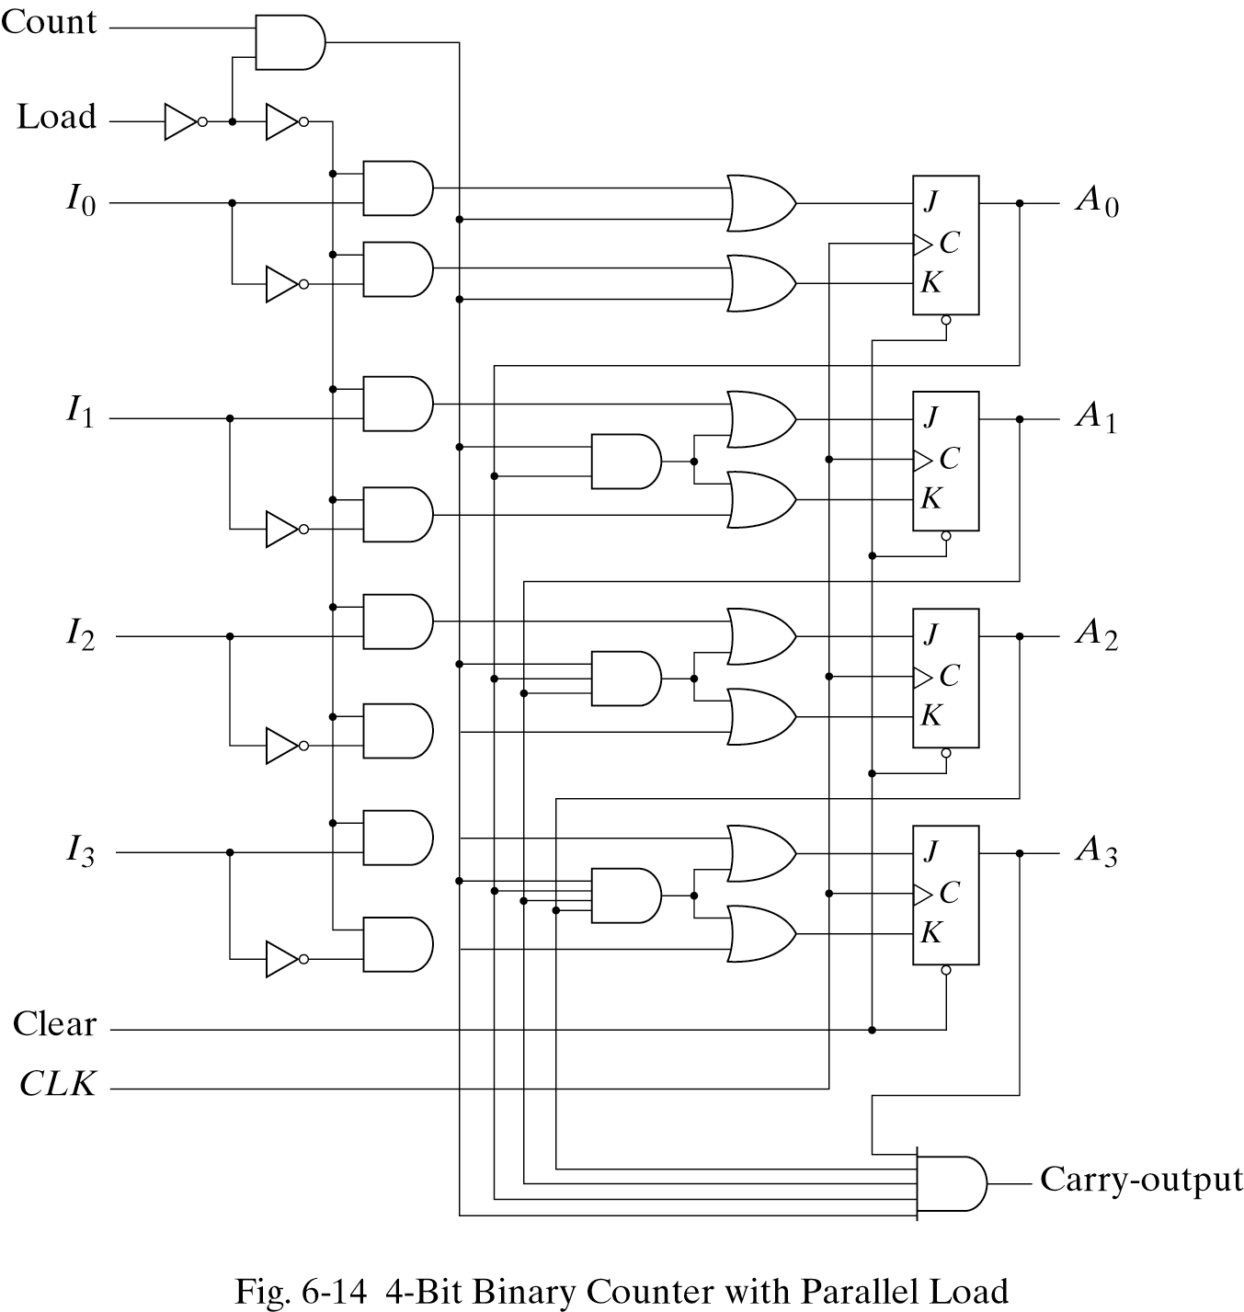
Binary Counter with Parallel Load
Sometimes we need an initial value prior to counting
Initial value: I3 I2 I1 I0

Slide 42
Binary Counter with Parallel Load
Count = 1, Load =0
1
1
0
1
0
0
1
0
0
1
0
0
0
1
0
0
0
0
1
1
0
0
0
0
1
0
0

Slide 43
Binary Counter with Parallel Load
Count = 0, Load =1
0
0
1
0
1
I0
I0
1
I0’
0
1
I1
I1
1
I1’
1
I2
1
1
I2’
1
I3
1
I3’

Slide 44
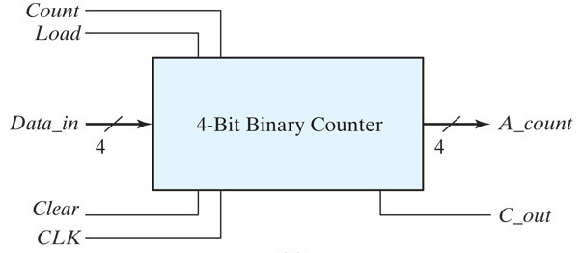
Question
Build a BCD counter using a binary counter with parallel load.
Assume Load is synchronous and Clear is asynchronous.

Slide 45
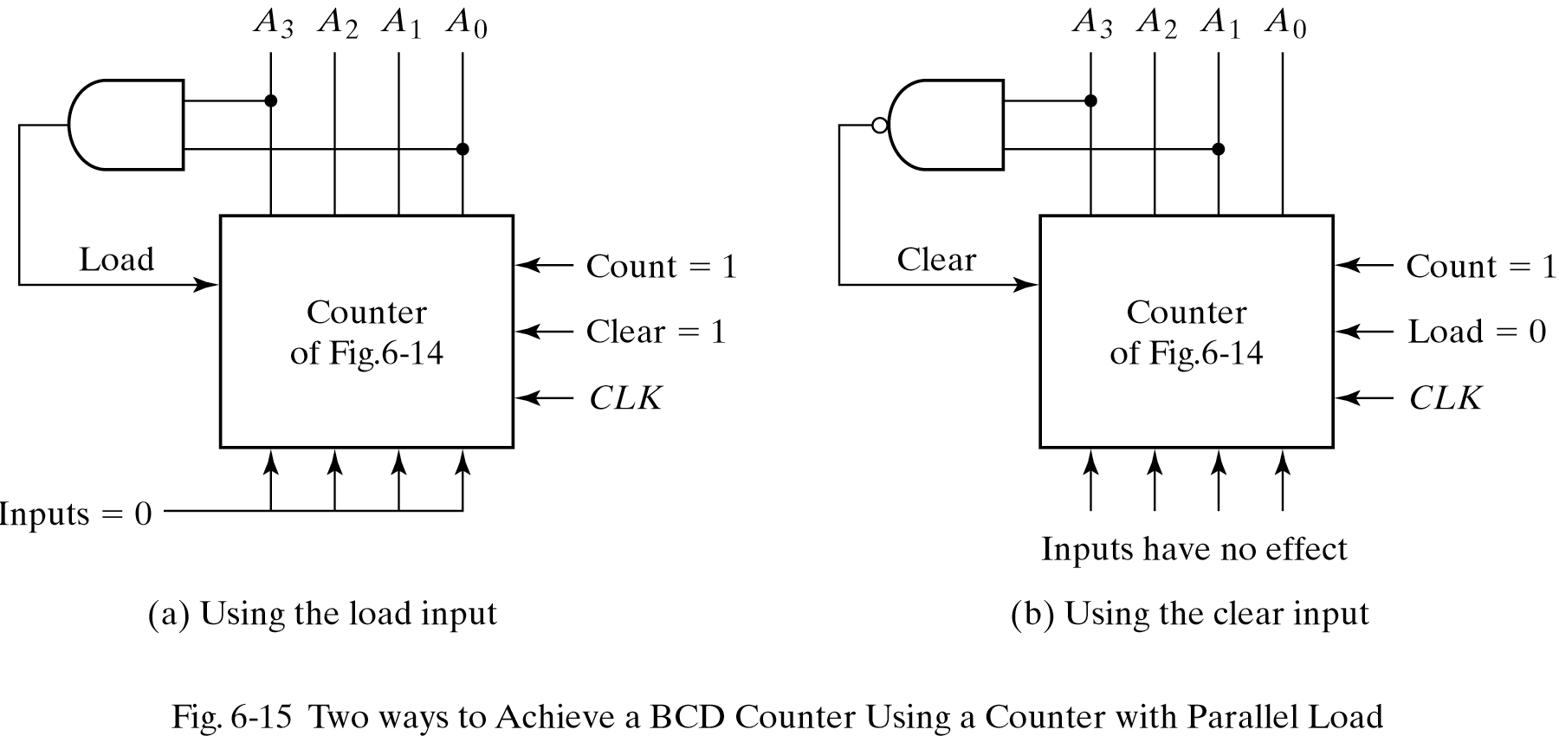
Binary Counter with Parallel Load
In (a), “1001” (9) is detected. In (b), “1010” (10) is detected. Why?
In (a), LOAD is set to 1 and effective next cycle. (LOAD is a synchronous control input)
In (b), counter is immediately cleared. (Clear is an asynchronous control input)

Slide 46
Counters with unused states
The examples shown so far have all had 2^n states, and used n flip-flops. But sometimes you may have unused, leftover states.
For example, here is a state table and diagram for a counter that repeatedly counts from 0 (000) to 5 (101).
What should we put in the table for the two unused states?
000
101
001
100
010
011

Slide 47
Unused states can be don’t cares…
To get the simplest possible circuit, you can fill in don’t cares for the next states. This will also result in don’t cares for the flip-flop inputs, which can simplify the hardware.
If the circuit “somehow” ends up in one of the unused states (110 or 111), its behavior will depend on exactly what the don’t cares were filled in with.
000
101
001
100
010
011

Slide 48
…or maybe you do care
To get the safest possible circuit, you can explicitly fill in next states for the unused states 110 and 111.
This guarantees that even if the circuit somehow enters an unused state, it will eventually end up in a valid state.
This is called a self-starting counter.
110
111
000
101
001
100
010
011

Slide 49
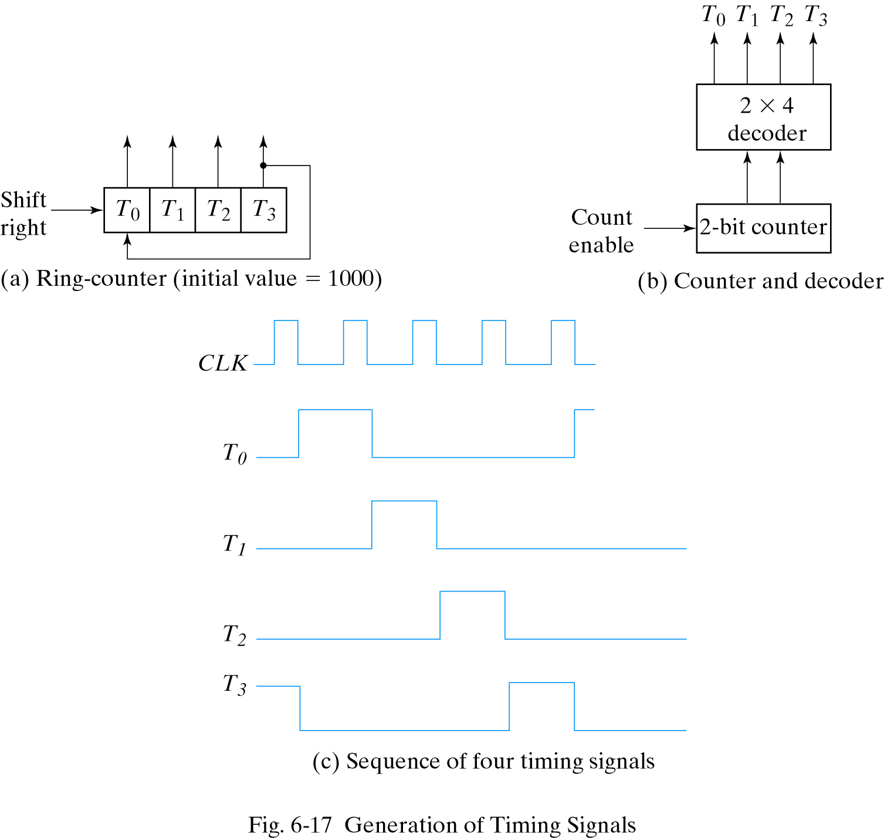
Other Counters: Ring Counter
A ring counter is a counter with ONLY one flip-flop set to 1 at any particular time, all others are cleared.

Slide 50
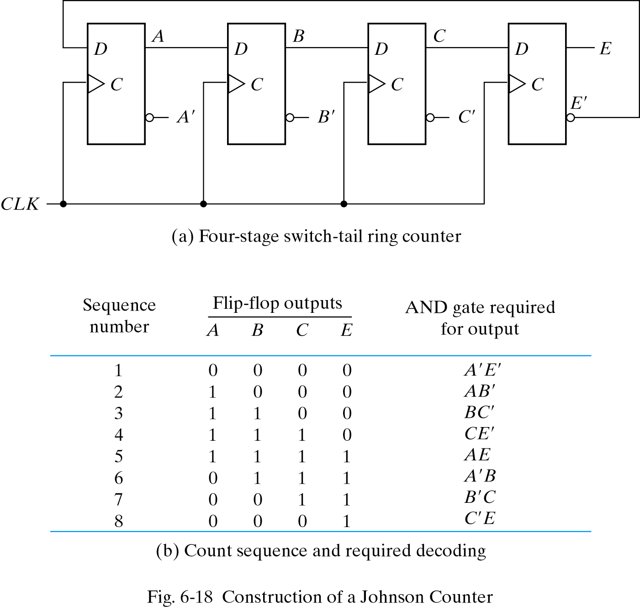
Other Counters: Johnson Counter
A 4 flip-flop ring counter that produces 8 states (not 4).
Where do we use it?

Slide 51
Registers - Summary
A register is a special sequential circuit that stores multiple bits of data.
Several variations are possible:
Parallel loading to store data into the register.
Shifting the register contents either left or right.
Counters are considered a type of register too!
One application of shift registers is converting between serial and parallel data.
Registers are a central part of modern processors, as we will see in coming weeks.

Slide 52
Counters - Summary
Counters serve many purposes in sequential logic design.
There are lots of variations on the basic counter.
Some can increment or decrement.
An enable signal can be added.
The counter’s value may be explicitly set.
There are also several ways to make counters.
You can follow the sequential design principles from last week to build counters from scratch.
You could also modify or combine existing counter devices.

